Slide 1
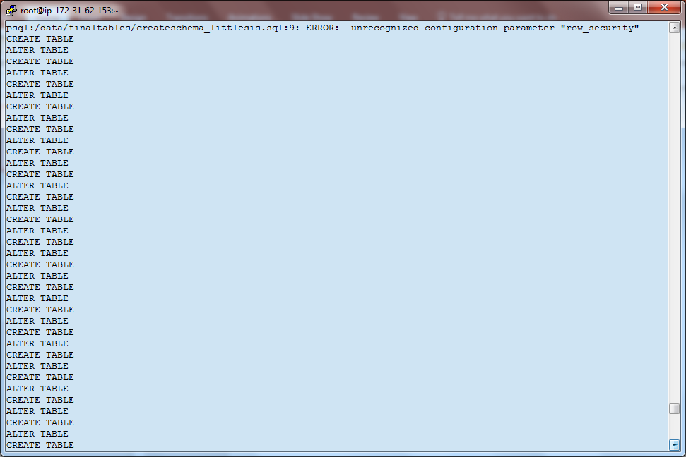
Create Schema for littlesis DB

Slide 2
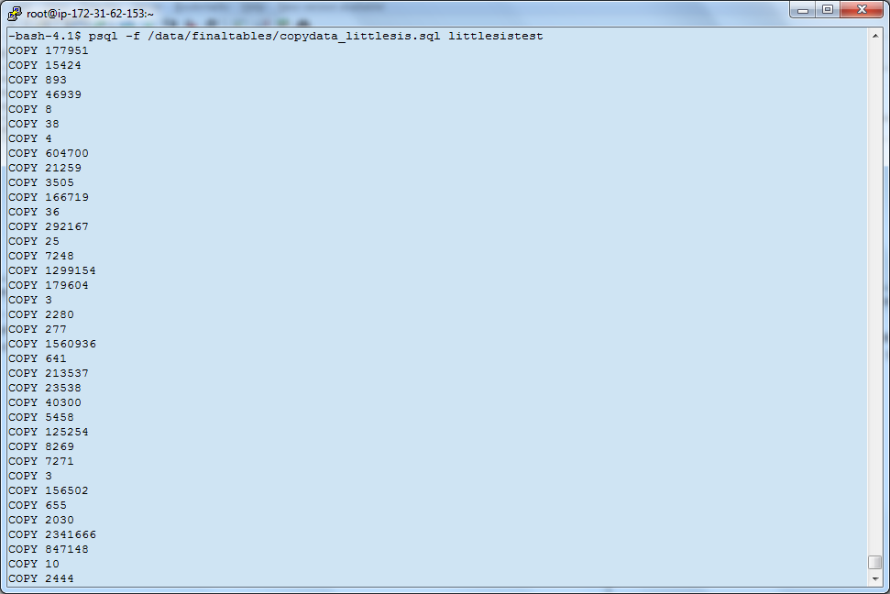
Copy data from CSVs

Slide 3
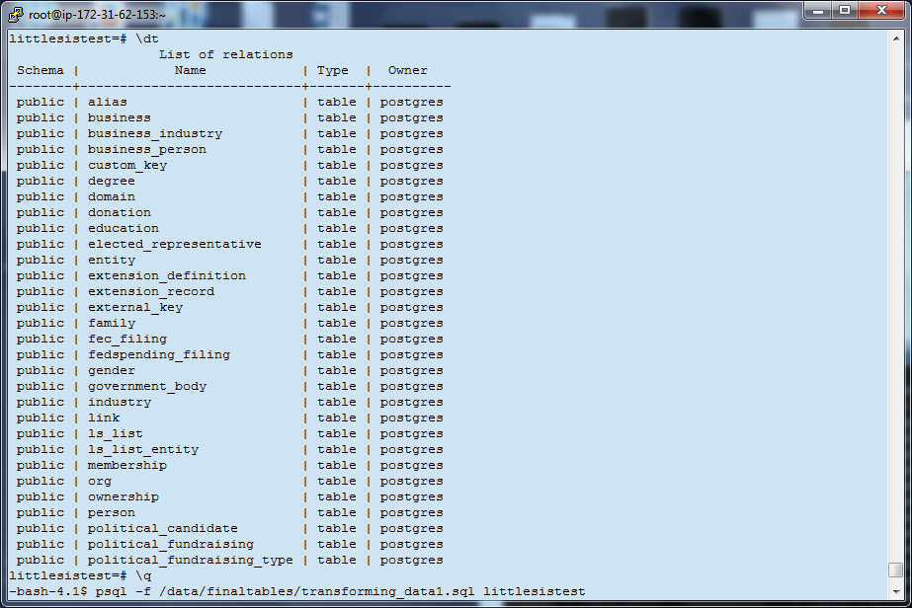
View of Native Database

Slide 4
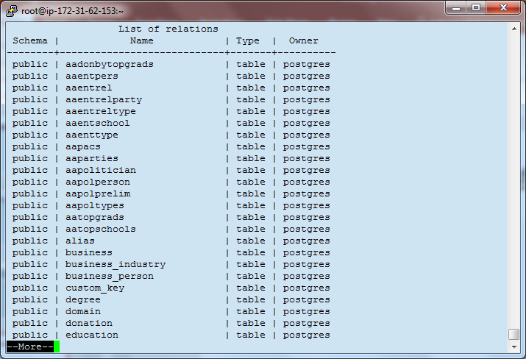
Create Query Tables: /transforming_data.sql
Query tables have prefix “aa”:

Slide 5
….

Slide 6
….

Slide 7
….

Slide 8
….

Slide 9
….

Slide 10
….

Slide 11
….

